Slide 1



How Austin ISD
Transformed School Board Communications

Slide 2
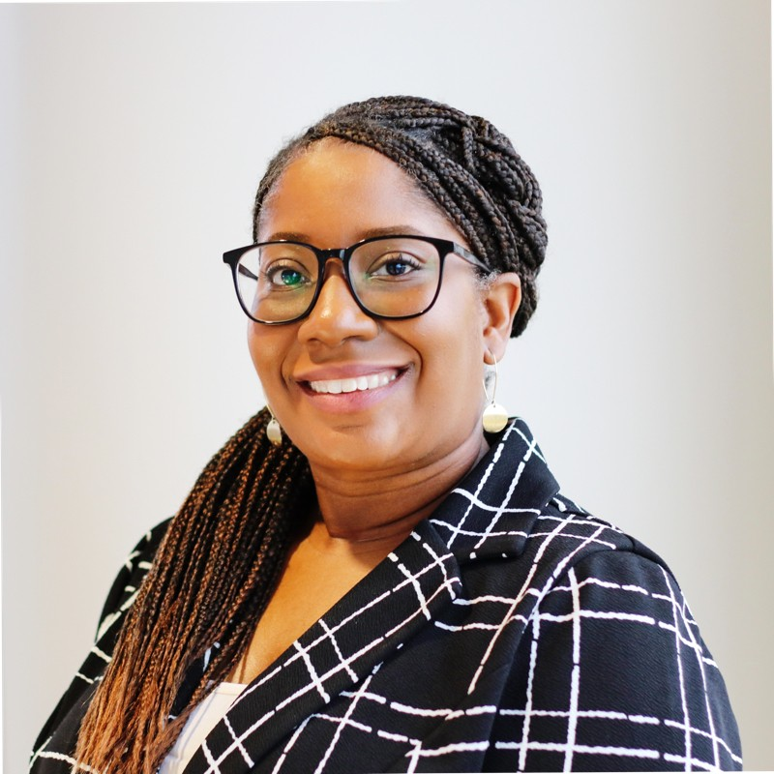

Welcome!
Stephanie Hawkins
Community Relations Coordinator
Austin Independent School District
Joe Douglass
Regional Account Director
K12 Insight

Slide 3

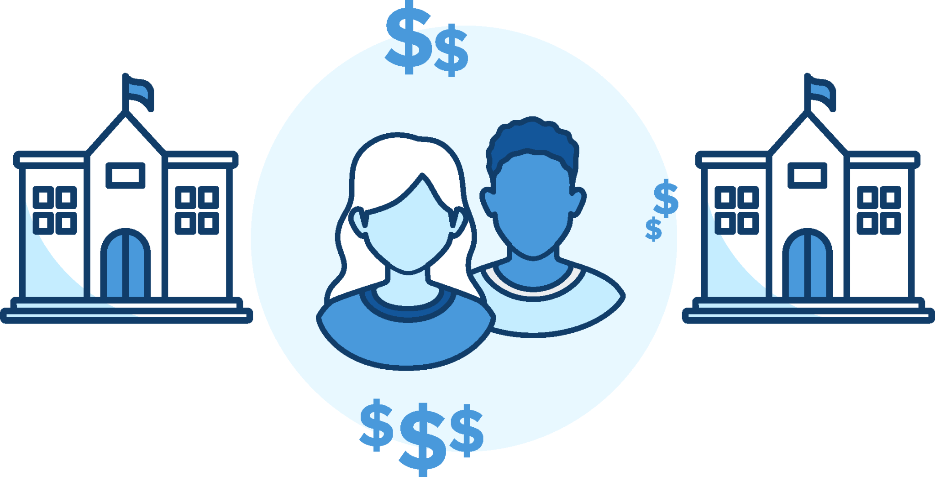

Radical paradigm shift in communications
Notes:
K12 INSIGHT
I’d like to start by talking about a radical paradigm shift we’re facing in education today. CLICK TO SHOW IMAGE. Many of the issues we’re dealing with are the same ones we’ve been talking about forever. Bus routes, graduation rates, test scores — these are the same issues families have always been concerned with. What’s changed is the volume of this communication. Your district has so many different entry points and families have so many different forums… the conversation is no longer private between you and Joe Parent. Joe Parent is likely online, having conversations about your district without you.
So the first paradigm shift is the volume of communications.
The second CLICK TO SHOW IMAGE is school choice. Once upon a time, you went to the school down the street. There wasn’t really another option. Today, we’ve got private schools, charter schools, parochial schools, even materials for the homeschooling option have gone through the roof in the COVID and post-COVID era. Families have options and many exercise them.
Here’s the thing. Every time a family walks out — that’s about 8K from your budget, sometimes more.
So these shifts are radical enough for us to be having this conversation as it is, but in 2023 the entire situation is exacerbated by social media. CLICK TO SHOW IMAGE. Everything that happens in your district is happening in full view of the world, online, 24/7.
What this paradigm shift creates is what we’ve come to call a “tangled web of communications”.
NEXT SLIDE

Slide 4


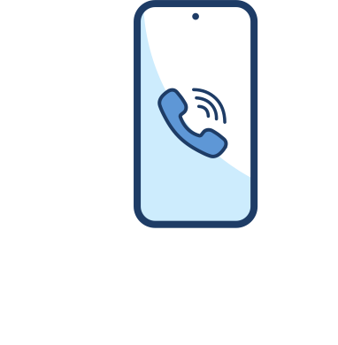







Inbound communications: A tangled web
School Board
Students
Superintendent
Department Head
Parents
Principal/campus
Assistant Principal
Teachers
Teacher
Staff
Community
Notes:
K12 INSIGHT
In an average district, let’s say you have ten or so entry points. And they’re all siloed.
Communications are coming in from so many different entry points, and they’re heading in so many different directions, it’s really no wonder we’re stuck playing catch-up and passing inquiries around on the backend — sometimes for days or weeks before we’re able to get a response back.
Communications is already tangled, but when you add in extra layers of equity it gets even more complicated
And this tangled web creates a significant risk for your school district.
NEXT SLIDE

Slide 5
The K-12 marketplace is competitive.
Every touchpoint is an opportunity to deliver superior customer service.
Notes:
K12 INSIGHT
That risk lies in the competitive nature of today’s K-12 environment.
From the bus driver that picks a student up on their very first day of school to the hand they shake as they cross the stage at graduation, superior customer service needs to be built into every single interaction.

Slide 6
To be the top choice…
…districts need to earn trust by providing superior customer service in addition to an excellent education.
Notes:
K12 INSIGHT
To be the top choice, to compete for and win the families in your area, you need to earn that trust by providing superior customer service.
I know we as educators don’t always love talking about these topics in such stark business terms, but this is the mentality that everyone else competing for students has adopted. If you don’t, you’re at a distinct disadvantage.
We’ve talked a lot about the families within your district who are at risk of leaving, but customer service is also they way you can market yourself to outside families looking for a new district.
Providing excellent education is no longer sufficient to keep families in your schools and encourage new families to join your district.
[NEXT SLIDE]
Additional context if desired:
“Customer service” is a term the business world and the private sector have been attached to for decades, but in the current K-12 marketplace, it’s something school districts can no longer deny.
We have competition in our industry now. Like we said earlier, families have a lot of options today… kids no longer have to go to the school right down the street. Because families are choosing to send their students to you, they are your customers. Because teachers are choosing to work for your district, they are your customers.
And to be the top choice in your city, in your area, you have to be delivering superior customer service IN ADDITION TO all the teaching and learning and educating we do on a daily basis.

Slide 7




Austin Independent School District at a glance
73,885
students
117
campuses
129,973
Let’s Talk dialogues
61,912
text
messages
Notes:
STEPHANIE
Brief overview of the district.
How I often describe our school district as a city within a city. We have over 73,000 students, 10,000 employees- makes us the 2nd or 3rd largest employer in the city of Austin. Since started using the Let’s Talk Platform in 2018, we have receive over 120,000 submitted dialogues and 48% of submitted dialogues were text messages.
[NEXT SLIDE]

Slide 8
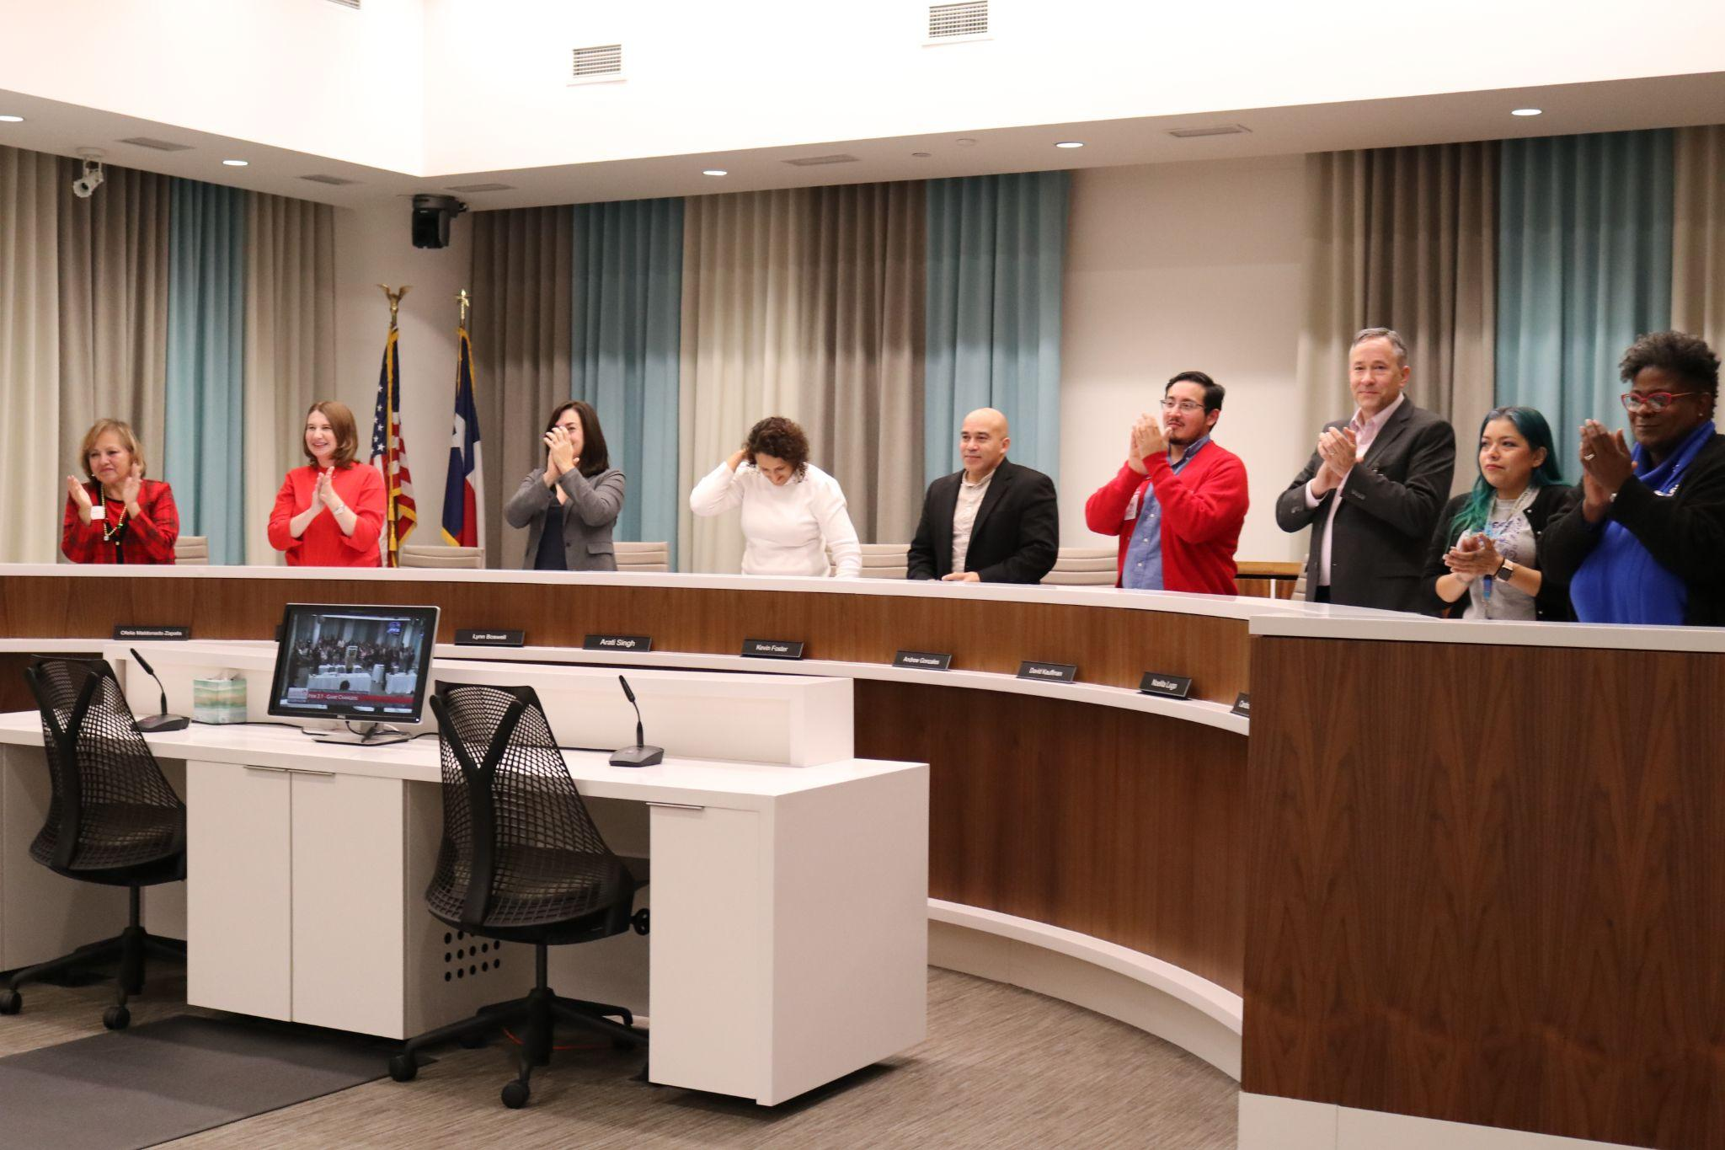
Our journey to enhancing board communications
We needed a solution that would help us:
Organize Trustee questions
Ensure accountability and confirmation of follow-through on requests
Improve speed and accuracy of responses
Foster collaborative, open communications
Notes:
STEPHANIE
Our history with board member communications starts many years ago, when questions were written down very informally, on paper with no accountability for follow-through. We eventually started using a spreadsheet, but again there was very little follow-through and no way to see whether or not questions had been answered and board members were satisfied with the responses.
There was also no way to track how quickly answers were being provided. After our 6 years of using spreadsheets, we elevated to a paid version of Smart Sheets, but this was just as inefficient.
We wanted more accountability and a higher-tech solution to help us ensure we were providing timely, accurate answers to board questions. We also wanted a way to work together with our board and save time for all involved. Our old system was lots of manual work for administrators.
Essentially, our goal was to….
[NEXT SLIDE]

Slide 9
We launched K12 Insight’s Let’s Talk customer service and intelligence platform!
We trained our Trustees to see data and track metrics. We worked with K12 Insight on an iterative improvement process.
We took the important first step of deciding we needed to transform our communications through Let’s Talk.
We worked hard to get buy-in from district leadership and department leaders.
Like many districts, we struggled with board communications and ensuring accountability.
We hosted many trainings and were diligent about ensuring senior leadership felt comfortable with the platform.
Notes:
STEPHANIE
So here’s kind of a timeline starting with everything I just discussed.
First, we were really struggling with board communications and accountability, so we made this decision to look for a new, streamlined communications platform.
We found Let’s Talk from K12 Insight… and I won’t lie, we struggled with buy-in from our district leadership. TELL STORY OF GETTING BUY-IN.
Once we had everyone on board, we launched in 2021.
But even after launching, we still struggled with buy-in from some department leaders and we worked really, really hard to get senior leadership on board with the new methods.
But it was so worth it! Once everyone was invested, we taught our Trustees how to use the platform to see metrics and data and, most importantly, to see the questions and answers from every parent so we don’t have miscommunication or duplicate efforts.
Now, we’re in a phase where we’re just continually making this a better and better process! K12 Insight has been a true partner as we navigate the ups and downs and necessary changes.
But, before I go too deep into the benefits we’ve seen, I want to share how this platform actually works…

Slide 10


I was bullied
on the school
bus today…
Students
What are the high school options for my daughter?
Parents
I need to change
my direct deposit information...
Teachers
How much will my taxes increase because of this levy?
Community
Notes:
STEPHANIE
When we decided to launch Let’s Talk for our districtwide communications, we were really excited about the possibilities. So if you remember that tangled web Krista was talking about earlier, Let’s Talk really solves for that.
Some of the solution features that drew us to Let’s Talk were:
The unified inbox that streamlines internal and external communications
The dashboard that offers quick and valuable insights from real-time stakeholder input and feedback
We wanted automated workflows to help eliminate repetitive tasks and save staff time
We brought this deeper into our structure because we wanted to respond the right way and support people as best we can — while still supporting our staff.
And when we started out, we never could have dreamed how much it would impact and positively change our board communications!
[NEXT SLIDE]

Slide 11

Our goal
Build mutually beneficial relationships based on shared expectations, while keeping both the board and the administration focused on their work.
Notes:
STEPHANIE
Read slide
And on top of this, we wanted to ensure the superintendent and the trustees had the same information, with all data adhering to open meeting laws.
[NEXT SLIDE]

Slide 12
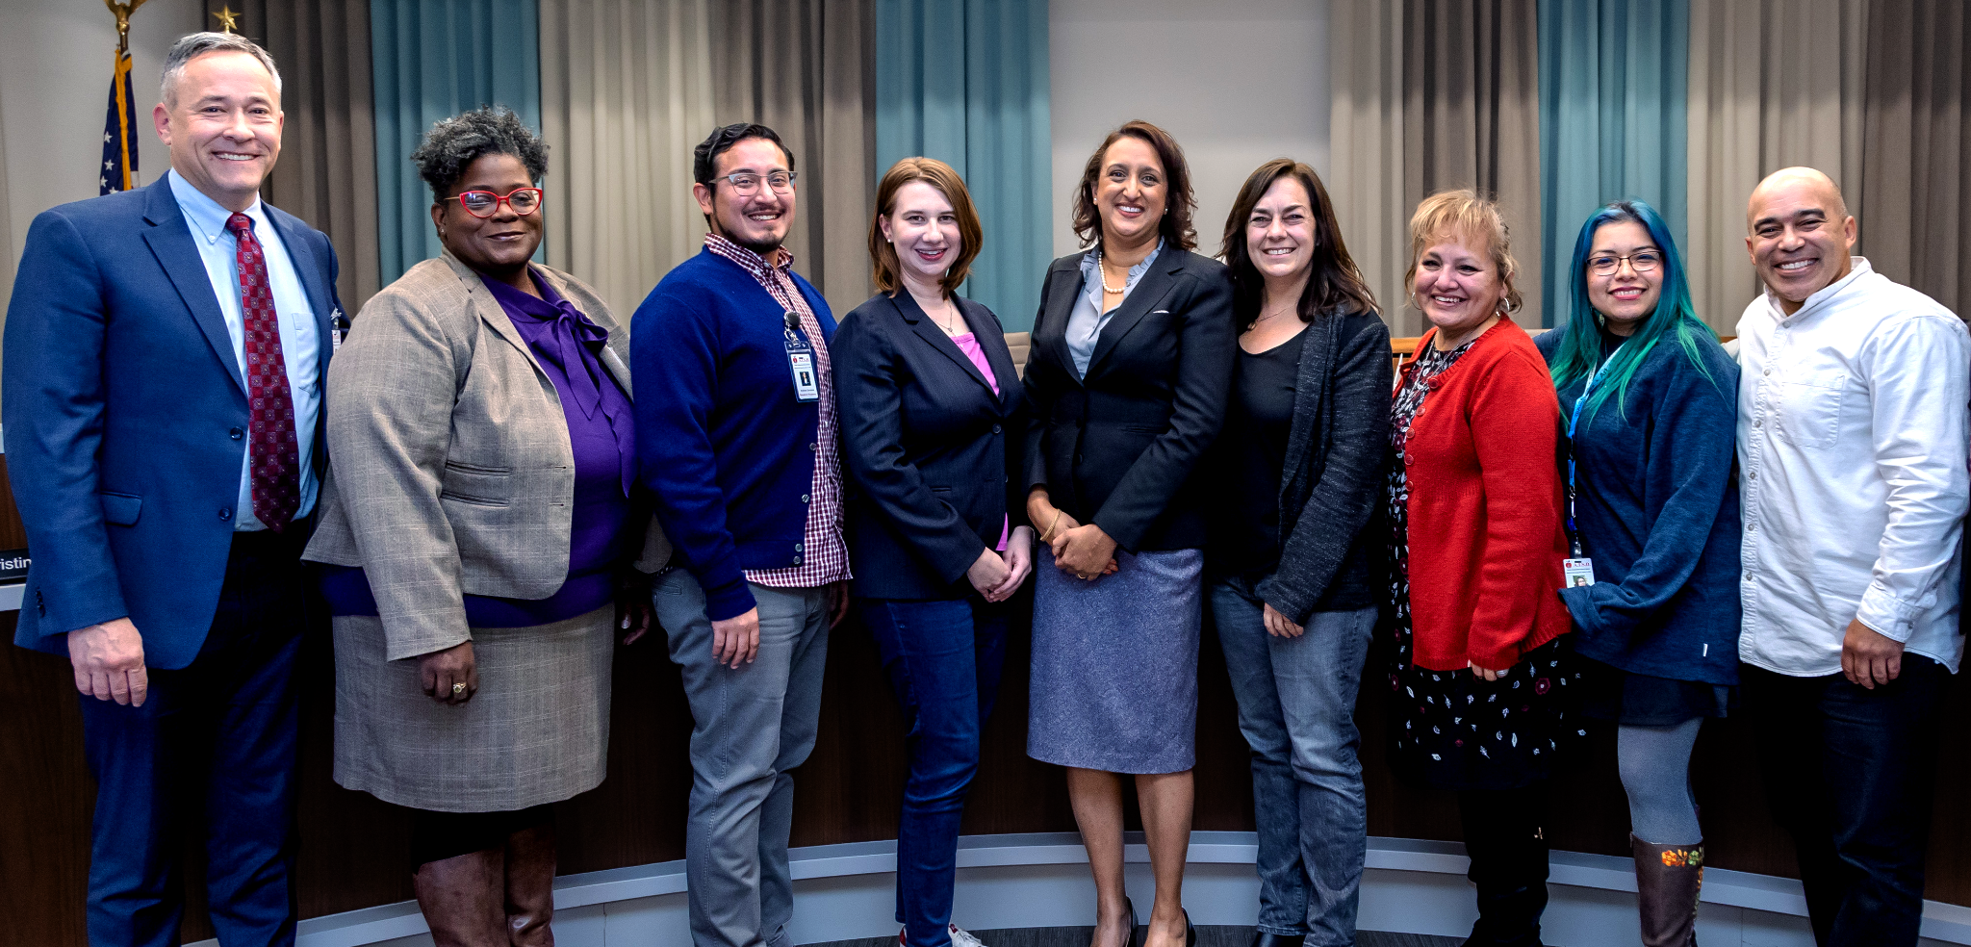


“Trustee Tracker”
Let’s Talk provides a unified inbox for managing board questions
The solution empowers our district administrators to:
Collect questions
Gather answers
Share timely, accurate information with our board members
Notes:
STEPHANIE
To help us reach this vision, we established the Trustee Tracker through Let’s Talk. We were already using Let’s Talk to manage other inbound inquiries from students, staff, and the community, and it had a lot of the elements we were looking to implement in our board communications, so it just made sense to bring everything into one platform. K12 Insight helped us structure the dashboard to help us navigate inquiries from board.
Now, it’s much easier for us to gather feedback and answer questions from our board, and we have a way to ensure they’re getting answers — and not only that, but they’re getting the right answers quickly.
Before this, board members would ask questions and any random member of district admin would work to get answers. Sometimes, board members might ask questions to just any administrator they saw — even a principal at a specific school site (who may not have the district vision) or the CFO (who only sees things from one perspective). They might also have had informal conversations with the superintendent, who would then go off and attempt to make connections for the board members to understand district operations.
Now, there is one specific place for all board members to ask questions and get responses.
So, you might be wondering how exactly this platform works, so let’s get into that for a moment.

Slide 13
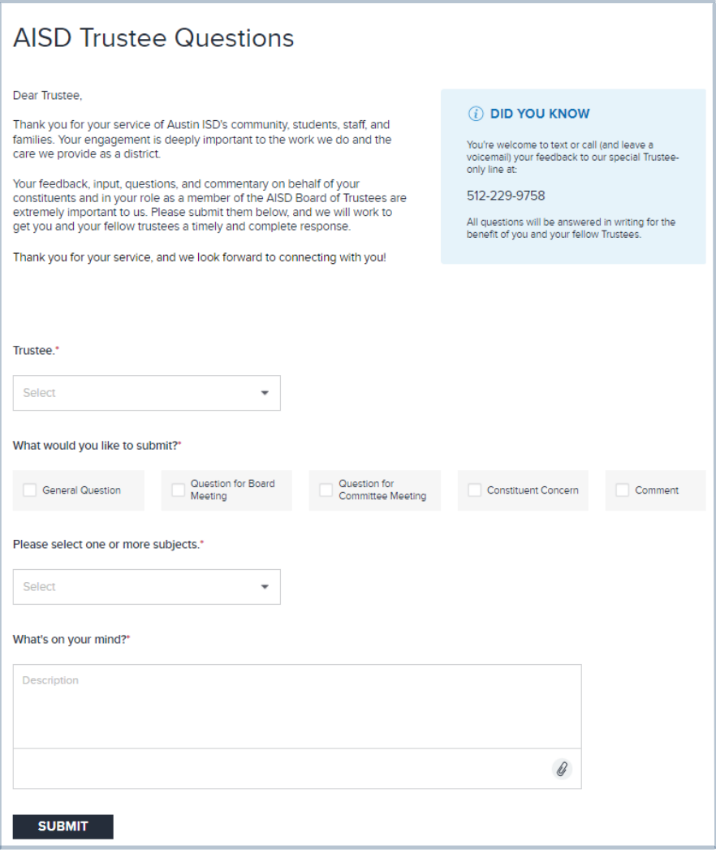
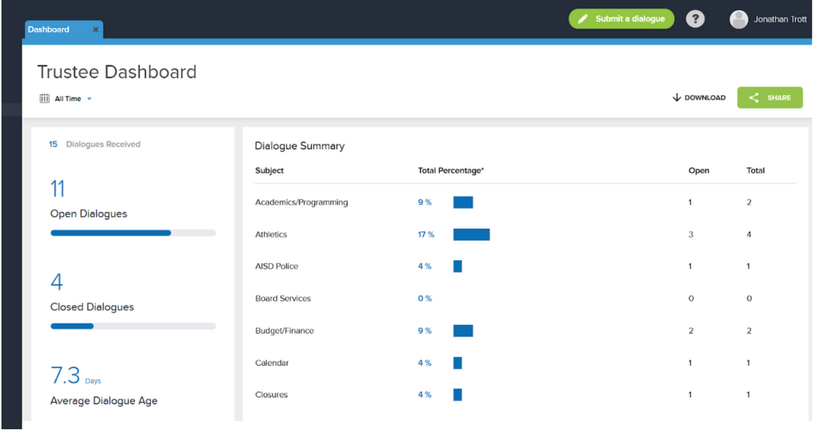
How it works:
Board members submit questions as Let’s Talk dialogues.
Trained and qualified members of district administration respond to inquiries.
Every board member receives an email with a copy of the question and answer.
Notes:
STEPHANIE
It’s pretty simple, the board members just go onto the website or their app to open Let’s Talk. They submit their question using the forms you see on screen.
Each board member has their own name on that drop-down, so they can just select their name and their information auto-populates, making it really easy for them to go in and make requests. And then there are 2-3 members of district administration who are trained and eligible to respond and provide answers.
The great thing about that is we’re absolutely sure that A) the answers are consistent and B) the answers represent the whole district, instead of just one department or school site.
And then, when the answers are given, they’re sent to every board member, not just the one who asked the question. So this has cut down on a lot fo repeat questions, because other board members don’t need to ask something that’s already been answered. So, we’re saving a lot of time on that front.

Slide 14

Board communications, simplified
Thanks to Let's Talk, board members now have:
A transparent view into all dialogues
Accountability between themselves and district leadership
Fewer repeated questions
Data for informing agendas and making future decisions
Notes:
STEPHANIE
Discussion of how the Trustee Tracker has supported communications with trustees — sharing more about the value this tool has provided for the district.
There have been a lot of benefits to implementing the Trustee Tracker through Let’s Talk, we’ve been able to accomplish a lot of what we set out to do with this platform.
We have transparency, partly because of what we talked about on the last slide, where every member of the board gets the questions and answers, but also internally, because we can track the response times and workflows on the backend — I can see when and by whom questions were answered, so we’re all accountable not only to Trustees but also to one another.
We’re saving time with fewer repeated inquiries, and another added benefit we didn’t anticipate was that we can use this data to build meeting agendas. You know, we know what topics are really hot because we’re getting a lot of related inquiries, so that tells us we should probably include it in the next agenda.
Also, for PEIMS reports — we used to have to manually count the number of questions + the amount of time it took them to answer at the end of every school year, but now we can use Let’s Talk to simply run a report identifying how many times a board member asked a question and the response time (based on tags). So that’s been hugely helpful.

Slide 15
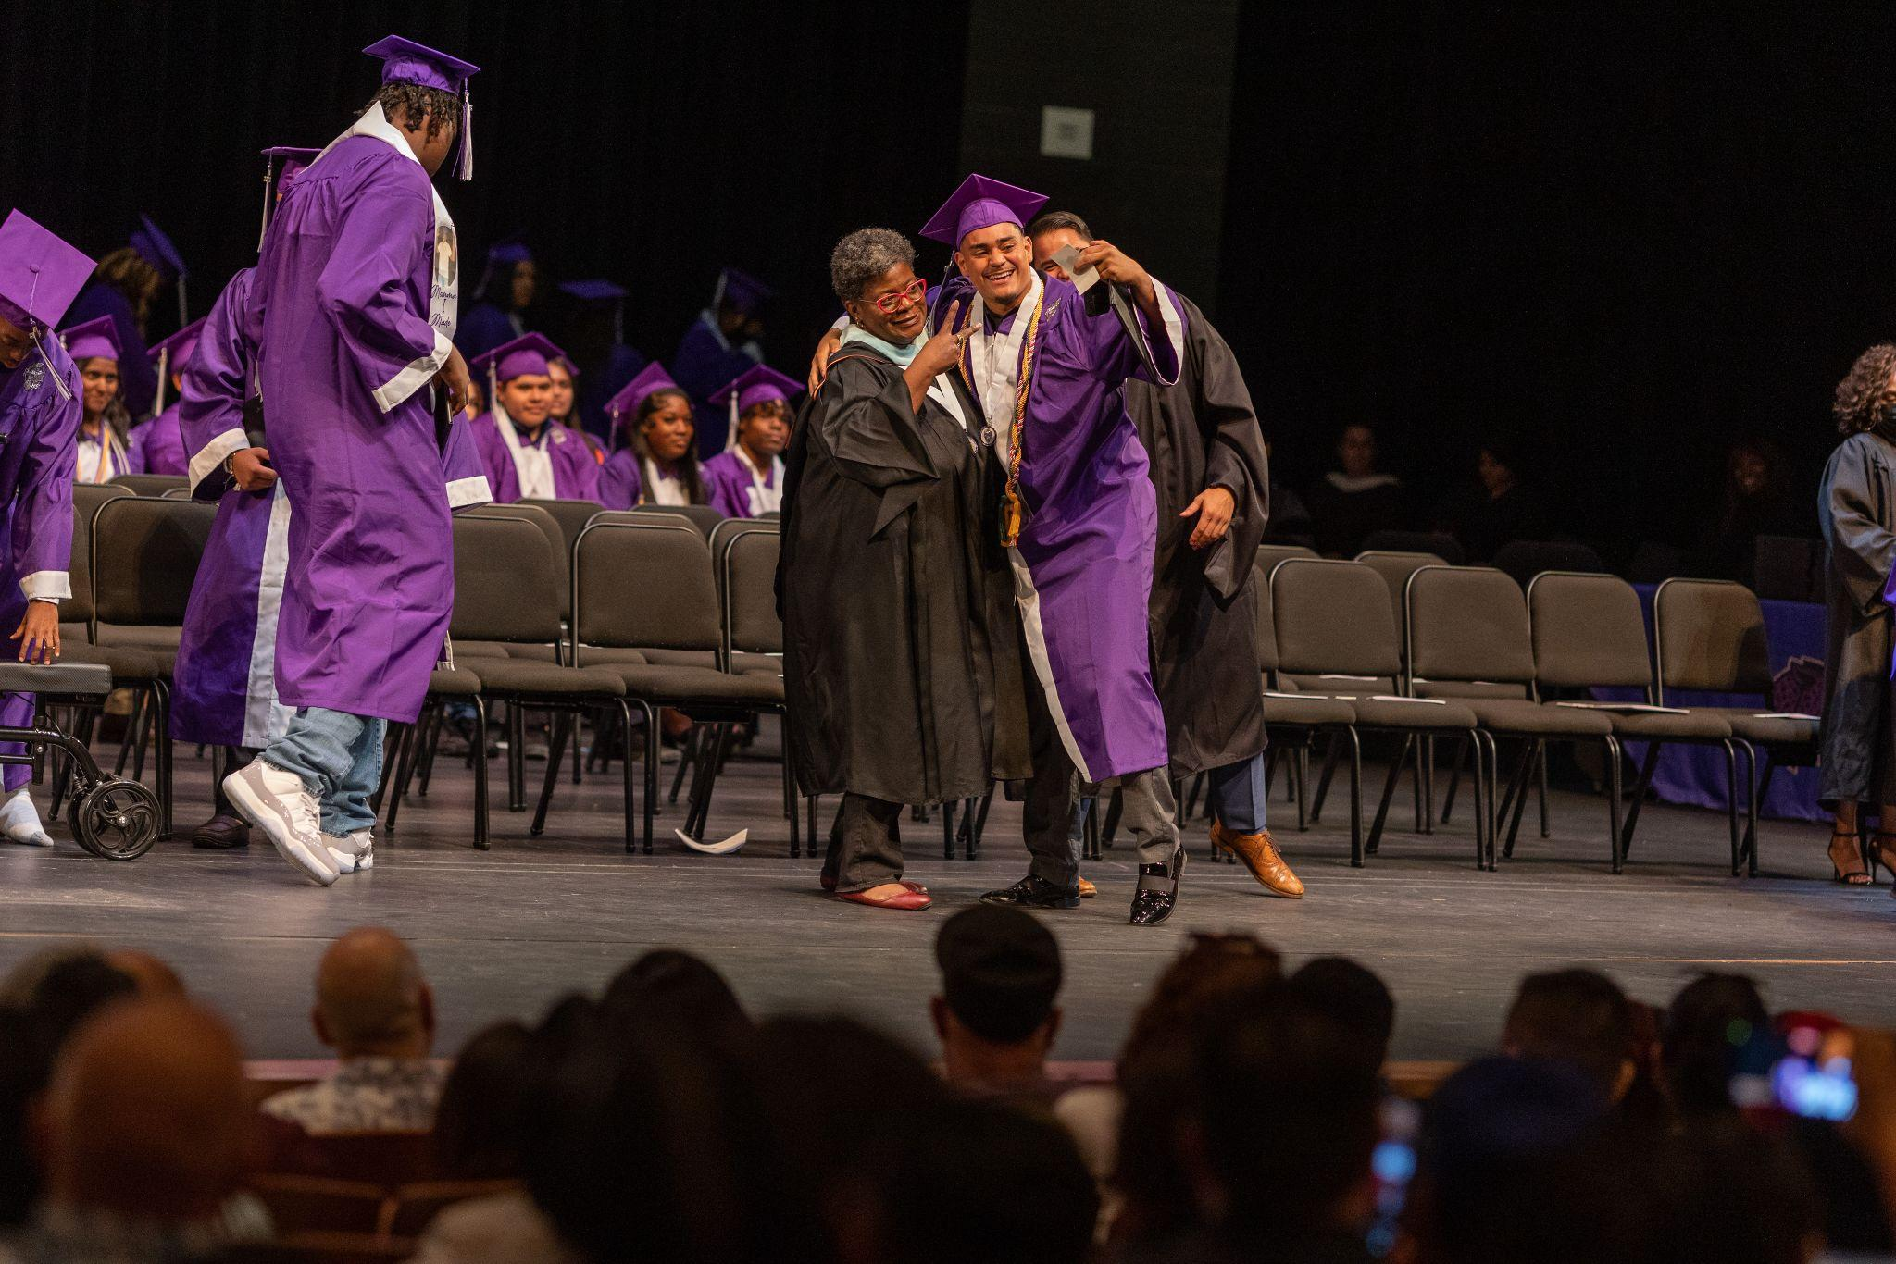

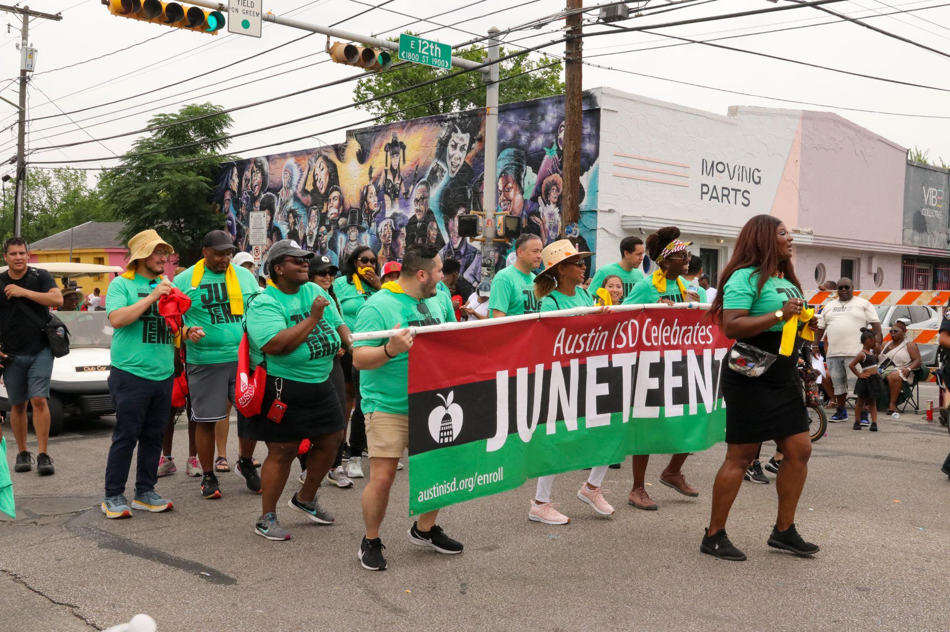


Slide 16
K12 Insight has been a true partner in this journey
Notes:
STEPHANIE
At first, we loved the idea of text messaging, but it was harder than we anticipated
We needed to answer the question of WHO can send dialogues
Within the TT, we’ve created parameters to ensure only certain people can respond.
K12 Insight was a partner, AISD worked with CSMs to build something that truly works and is beneficial !

Slide 17
Questions?

Slide 18
Thank you!
For a free, no-obligation customer service workshop, contact:
Contact Joe Douglass
joe.douglass@k12insight.com
Questions about the Austin ISD’s Trustee Tracker & Austin ISD’s Let’s Talk:
Contact Stephanie Hawkins
stephanie.l.hawkins@austinisd.org

